Slide 1

CRUDE OIL PRICE PREDICTION
MENTORS: KARTHIK MUSKULA &
DHANYAPRIYA SOMASUNDARAM

Slide 2

Team Members
1) Chintha Vishnu
2) Boddu Nandhini
3) Eragadindla Divya
4) Aadi Naveen Kumar
5) Nara Pradeep Kumar
6) Bharat Patil

Slide 3

Business Problem:
With a global trading price of 88$ per barrel, oil prices have hit an all-time high in the last seven years. Due to rise in oil price the economy are getting affected very badly.
Objective:
Oil is a product that goes completely in a different direction for a single market event as the oil prices are rarely based on real-time data, instead, it is driven by externalities making our attempt to forecast it even more challenging
As the economy will be highly affected by oil prices our model will help to understand the pattern in prices to help the customers and businesses to make smart decisions.

Slide 4
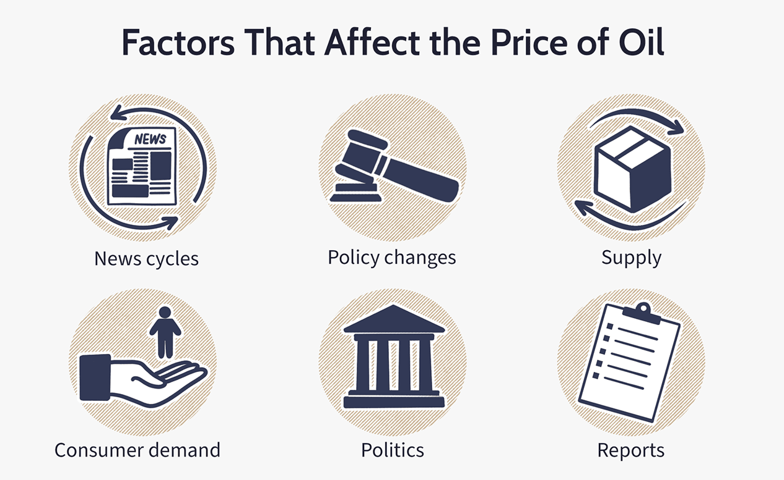
Oil Prices get affected by most of the factors , but the one’s that affect the most are demand and supply

Slide 5
Project Architecture / Project Flow
Understanding business problem
Model deployment
Collection of data
Model building
Cleaning of data
Exploratory data analysis

Slide 6
Dataset
Downloaded the crude oil price dataset from NASDAQ website.
Dataset has total 9345 rows and 2 columns which includes the crude oil price data from 02-01-1986 to 21-12-2022.

Slide 7
Exploratory Data Analysis (EDA)

Slide 8
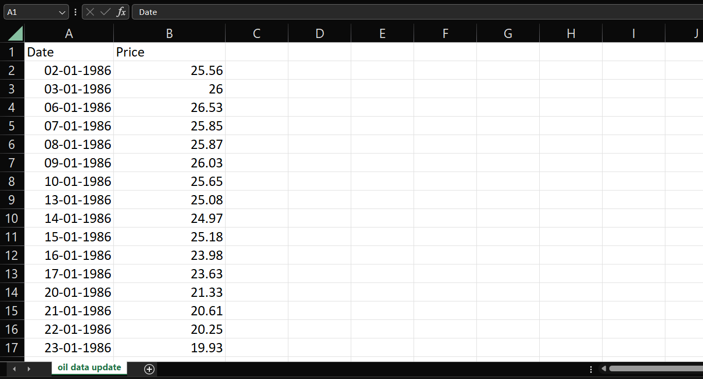
Dataset Details
Dataset contains 9345 rows and 2 columns
Datatypes are DataTime and Float
Data ranges from
02-01-1986 to 21-12-2022.

Slide 9
Exploratory Data Analysis (EDA)
Dataset has total 9345 rows and 2 columns which includes the crude oil price data from 02-01-1986 to 21-12-2022.
Calculated Mean, Median, Variance, Skewness, Kurtosis. Mean = 46.028511, Median = 36.060000, Variance = 871.16243,Kurtosis = -0.553953 (Flat peak or Platykurtic), Skewness = 0.761338 (Positive Skewness or Right skewed).
We found that the dataset has 6 null values. We applied mean imputation technique to remove the null values from the data.
Calculated the correlation between Price and Year. Correlation = 0.723501 (Positive correlation)
We used outlier detection technique (Histogram, Boxplot, Describe function) and found that the data has some outliers.
We used boxplot formula to calculate the upper extreme and lower extreme values and removed the outliers using drop function.
Finally, null values and outliers have been removed from the data.

Slide 10
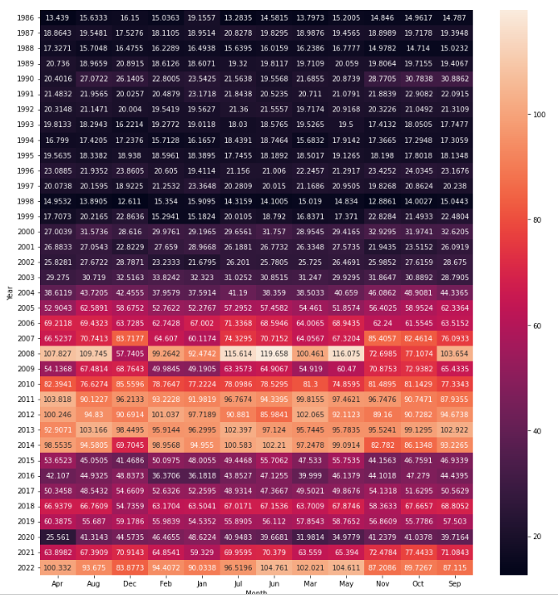
Heat Map
Inferences:
Since Heatmap provide us easy tool to understand the correlation between two entities, we used the heatmap to represent the correlation between the two variables year & month.

Slide 11
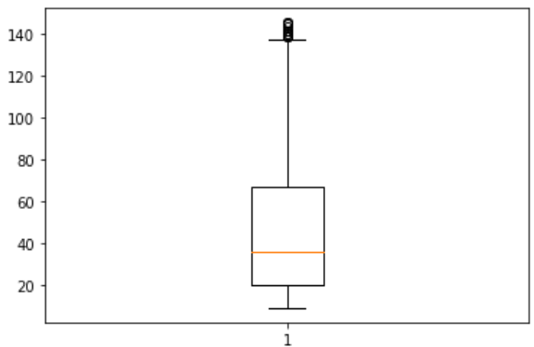
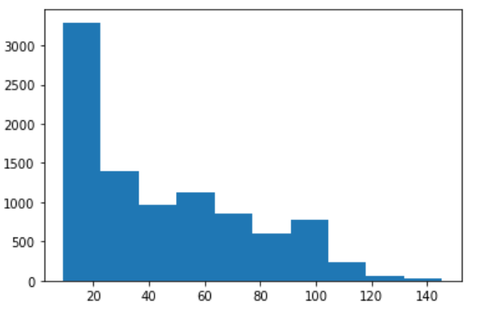
Outlier Detection
Inferences:
There are outliers above the positive upper extreme whisker.
There are no outliers below the negative side of the lower whisker.
Here the data doesn't follow Normal Distribution. Right skewed data.

Slide 12
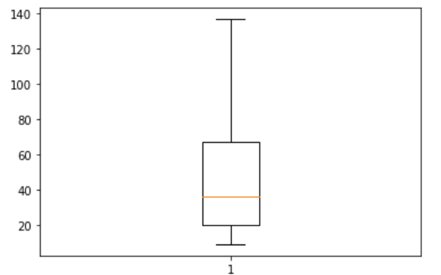
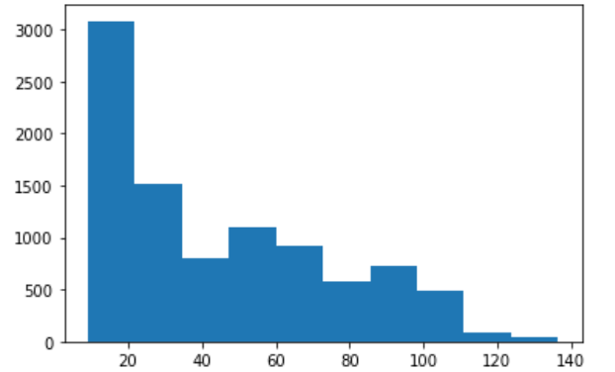
After dropping outliers
Inferences :
There are no outliers above the positive upper extreme whisker.

Slide 13
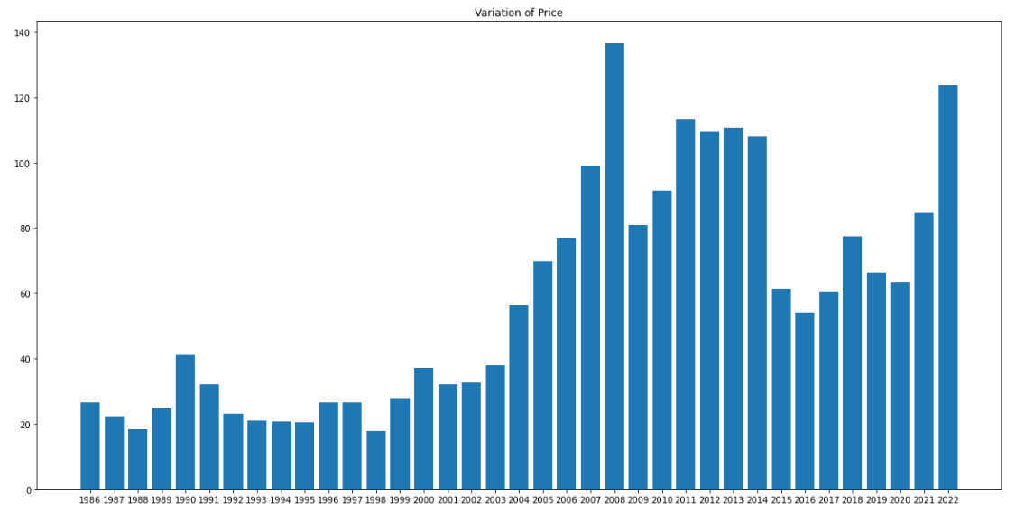
Data Visualization
Bar Plot of Variation of Price over Years

Slide 14
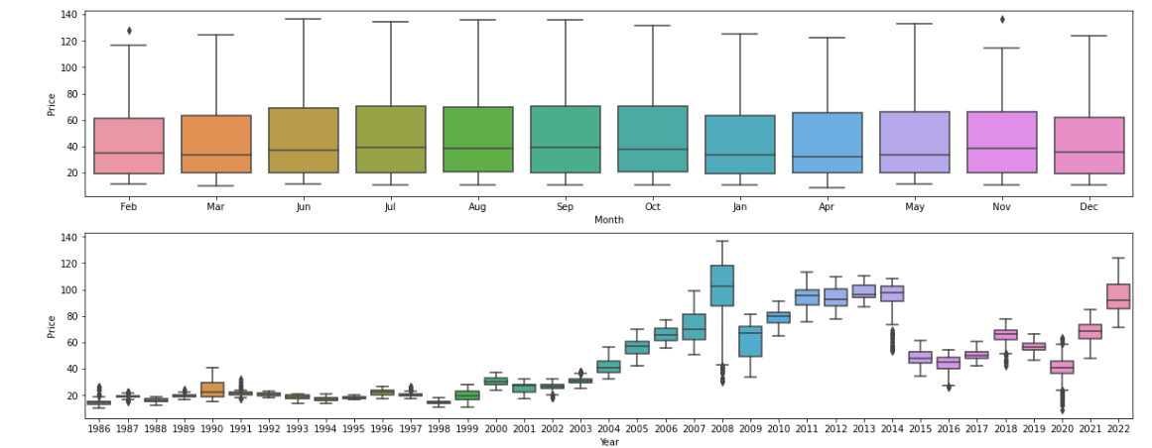
Box plot
BOX PLOT : Inferences :- Years 2018 and 2020 show outliers. 2018 The price of oil dropped in November 2018 because of a number of factors, including "rising petro-nations' oil production, the U.S. shale oil boom, and swelling in North American oil inventories," according to Market Watch. 2020 As rising Covid cases prompted fears of demand slowdown, due to that the price of the oil dropped.

Slide 15
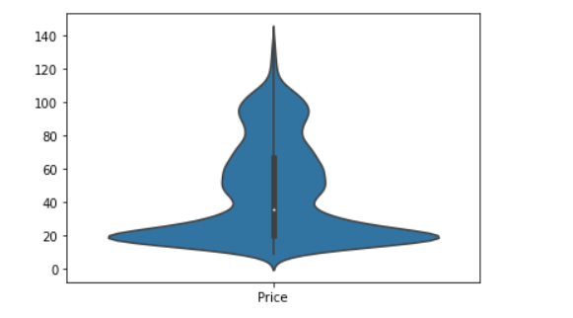
Violin plot
Shows the distribution of data numeric data.

Slide 16
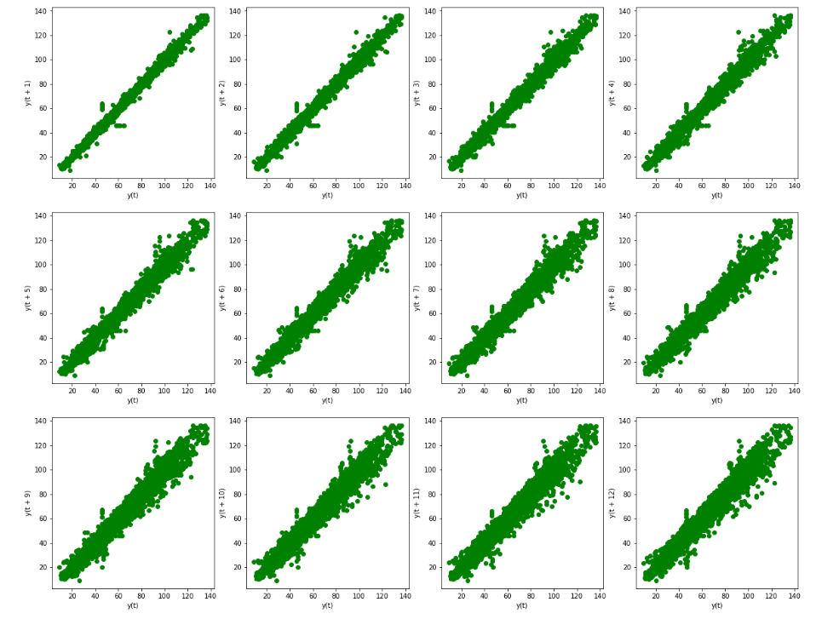
Data Visualization
Lag plots (yearly)
A lag plot is a special type of scatter plot in which the X-axis represents the dataset with some time units behind or ahead as compared to the Y-axis. The difference between these time units is called lag or lagged and it is represented by k.
Inferences:The series is showing autoregressive nature hence it is good for time series modelling.
lag scatter plot gives a Positive correction relationship . Hence they can be modelled.

Slide 17
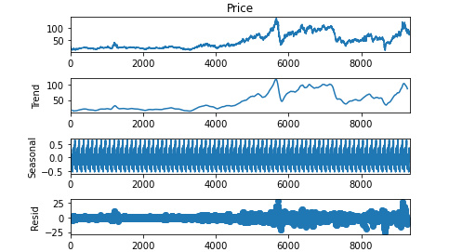
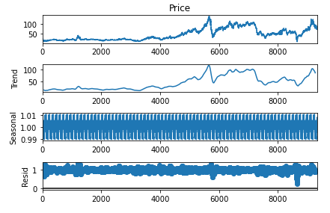
Time series Decomposition Method

Slide 18
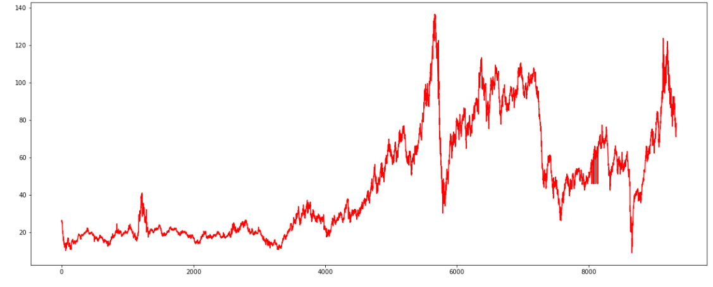
Time Series Smoothing
Inferences:
There is an exponential trend in Moving average & it shows orginal Oil Price data.

Slide 19
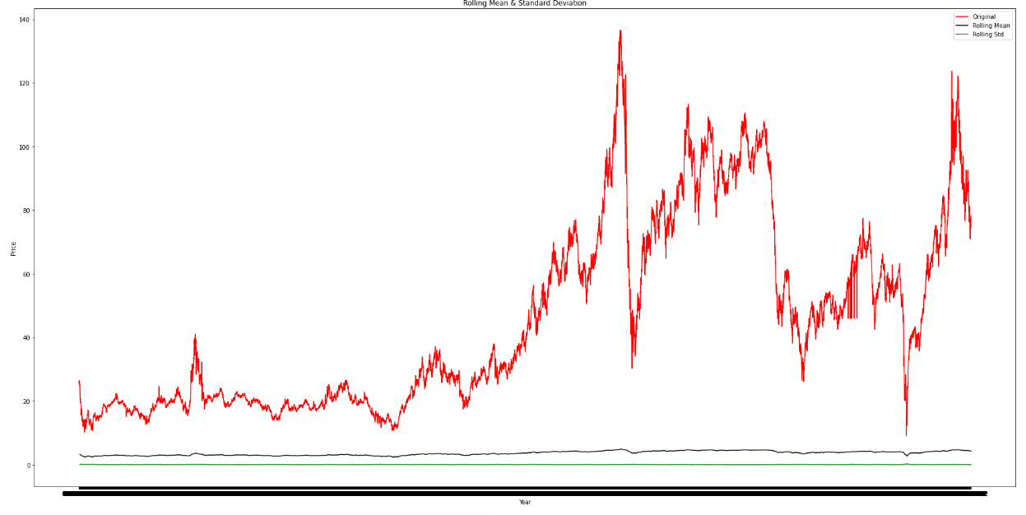
ADFULLER TEST before applying transformations
Null hypothesis = non-stationary; Alternate hypothesis = Stationary
If p-value < 0.05 - reject null hypothesis else accept alternate hypothesis.
Test statistic: -2.3318047632916876
p-value: 0.16191534495545917
Critical Values: {'1%': -3.431053874661101,
'5%': -2.861851068123899,
'10%': -2.566935576484507}
Here, the p value is greater than 0.05 (Critical value). So, Accept Null hypothesis i.e., The data is non stationary.

Slide 20
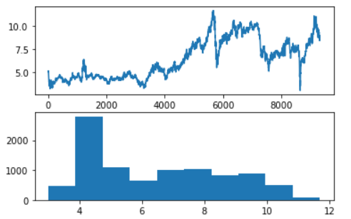
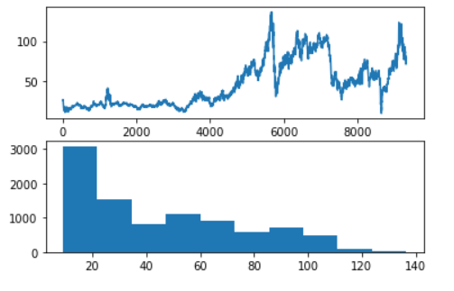
Applying tranformations to convert non-stationary data to stationary data
Linear transform
Square root transform

Slide 21
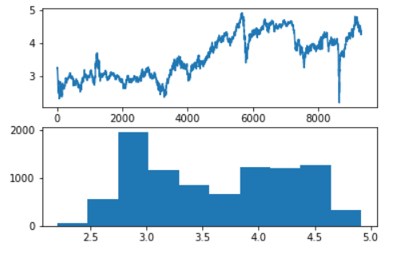
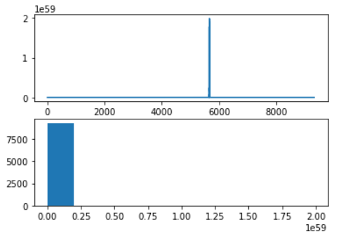
Log transform
Exponential transform

Slide 22
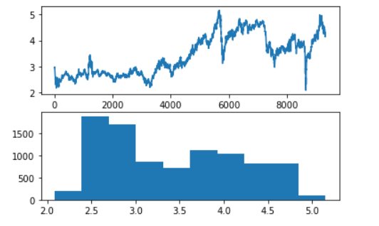
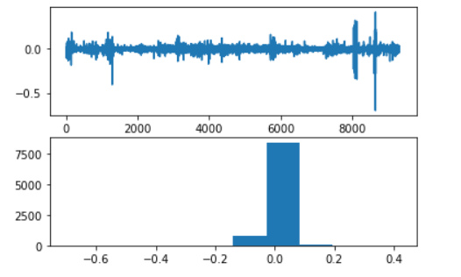
Cube root transform
Log differencing transform

Slide 23
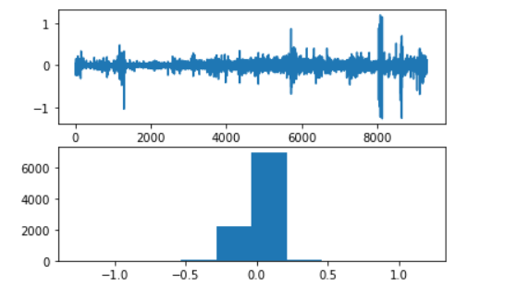
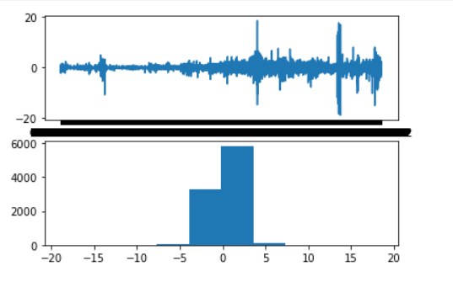
Square root differencing transform
First order differencing transform

Slide 24
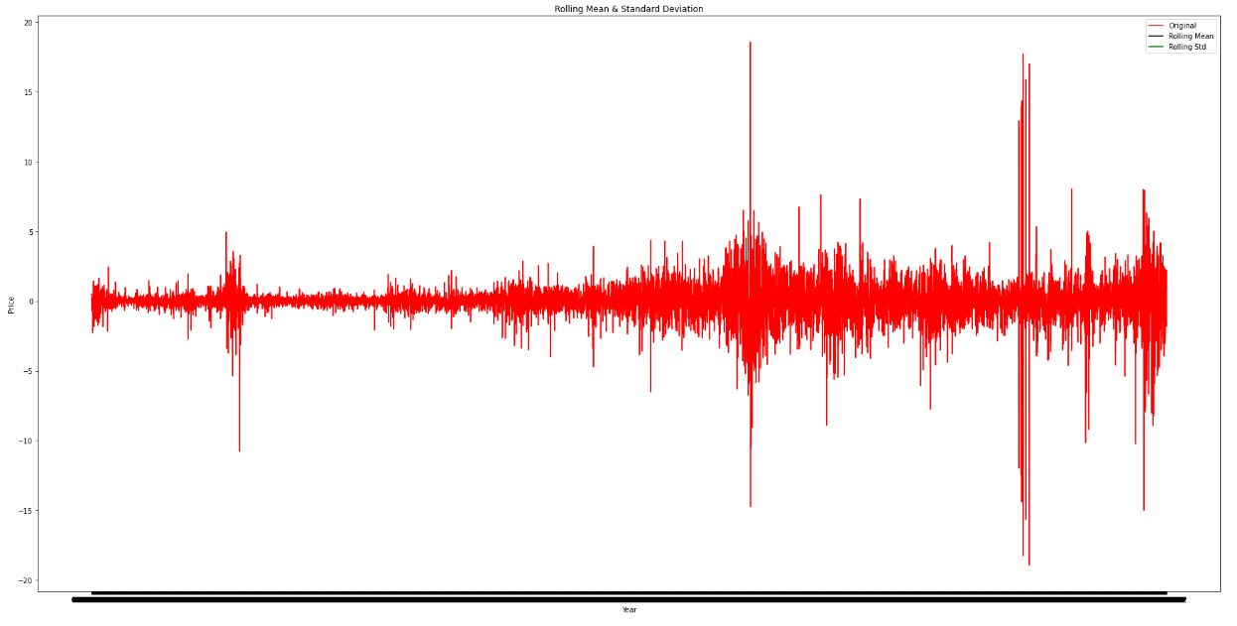
ADFULLER TEST after applying transformations
Nul hypothesis = non-stationary;
Alternate hypothesis = Stationary
If p-value > 0.05 - accept null hypothesis(data is non stationary) else accept alternate hypothesis(data is stationary)
Test statistic: -13.864850158434743
p-value: 6.626515507284801e-26
Critical Values: {'1%': -3.431053874661101,
'5%': -2.861851068123899,
'10%': -2.566935576484507}
Here, the p value is less than 0.05 (Critical value). So, Accept Alternate hypothesis i.e., The data is stationary.

Slide 25
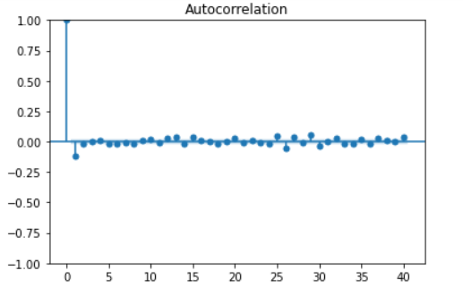
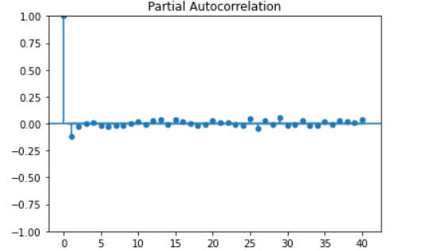
ACF and PACF plots for the transformed data

Slide 26
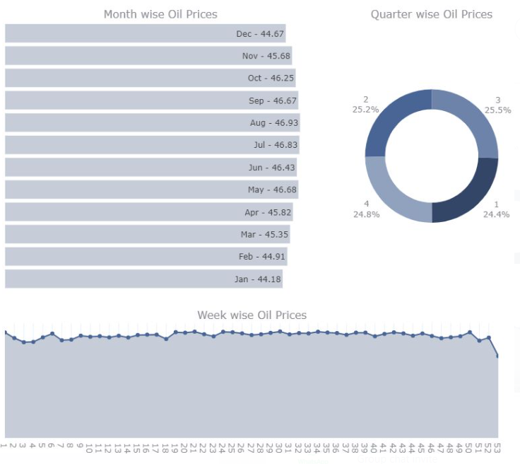
Inferences:
1) As we saw in the chart there is an upward trend in Prices over the time. Although there are ups and downs at every point in time, generally we can observe that the trend increases. Also we can notice how the ups and downs seem to be a bit regular, it means we might be observing a seasonal pattern here too.
Let’s take a closer look by observing some
year’s data
2) August month has the highest sales.

Slide 27
Model Building

Slide 28
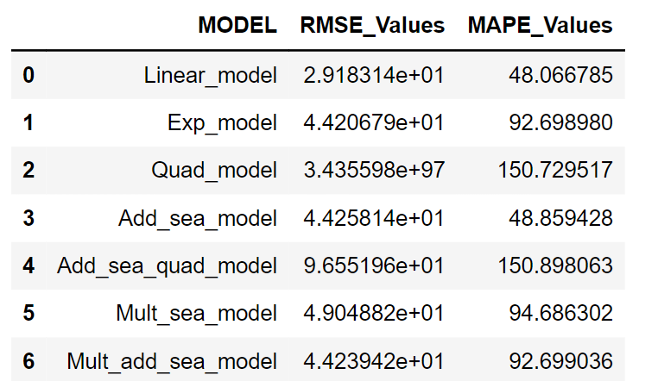
MODEL BASED METHODS

Slide 29
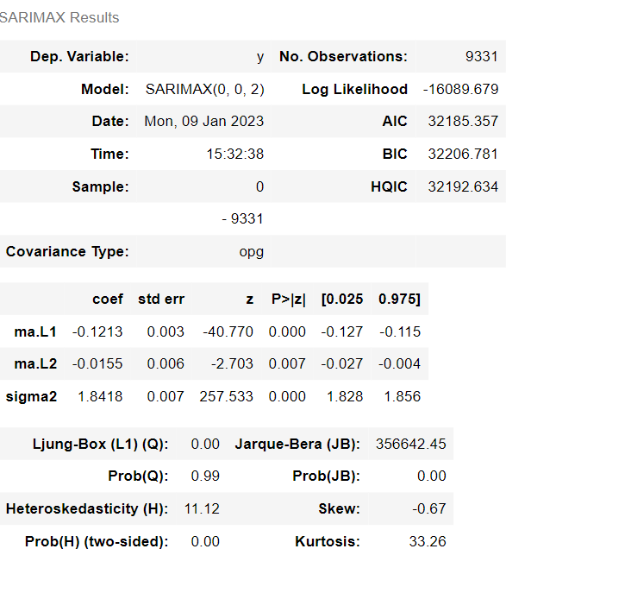
ARIMA Model
Splitting the data into train and test
Train data = 66.6%
Test data = 33.4%
Model with order = (0, 0, 2)

Slide 30
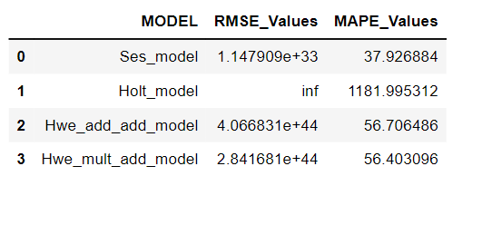
Data Driven Methods

Slide 31
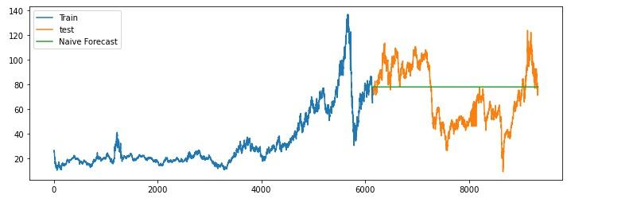
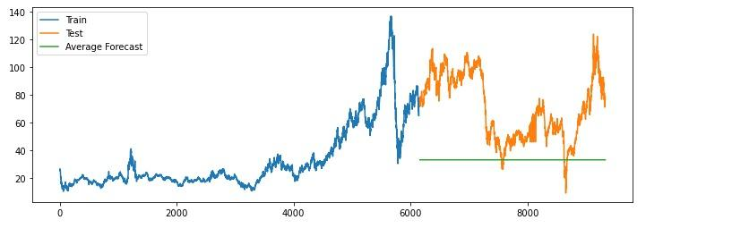
Naive Model (Last Sample Method)
Simple Averages Method
Train: 6159
Test: 3173
Train3 = data10.head(6160)
Test3 = data10.tail(3172)
rmse:224710588217780.16
rmse:6.389729471063823e+33

Slide 32
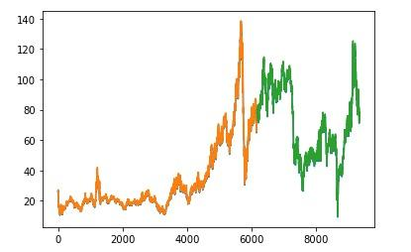
Long Short Term Memory (LSTM) Model
Train Score: 1.19 RMSE
Test Score: 2.04 RMSE
Train-R2 score: 0.9973721176476127
Test-R2 Score: 0.99215850176137

Slide 33
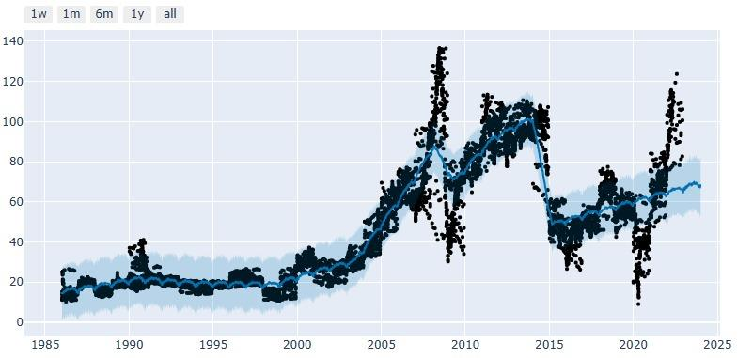
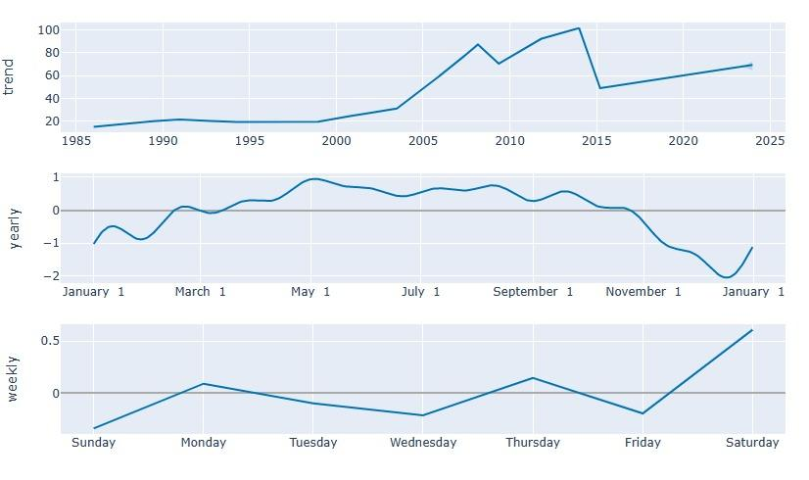
FB Prophet Model
Train2 = data11.iloc[:len(data11)-150] # Total data except last 150 observations
Test2 = data11.iloc[len(data11)-150:] # Only last 150 observations
Result:
rmse: 9.83
MAE: 6.16
MSE: 96.54
R-squared Score: 0.88
Components
observations

Slide 34

Model Deployment using Streamlit

Slide 35

Crude Oil Price Forecasting
This data app uses Facebook’s open-sources prophet library to automatically generate future forecast values from imported dataset. You’ll be able to import your data set from a CSV file, visualize trend and feature, analyze forecast performance, and finally download the created forecast

Slide 36
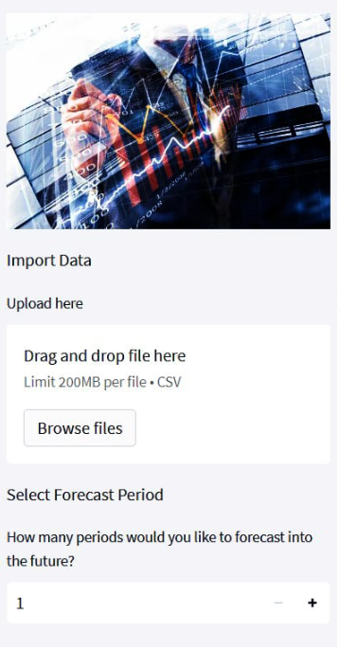
Uploading the dataset
Here, the user should upload the dataset and enter the number of forecast periods for which he want the predictions.

Slide 37
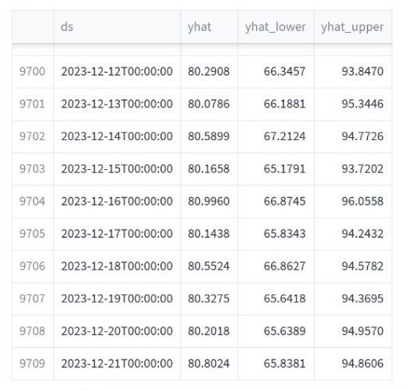
Visualized forecast data
This visual shows future predicted values of the next 365 days. "yhat" is the predicted value, and the upper and lower limits are (by default) 80% confidence intervals.

Slide 38
Visualizations

Slide 39
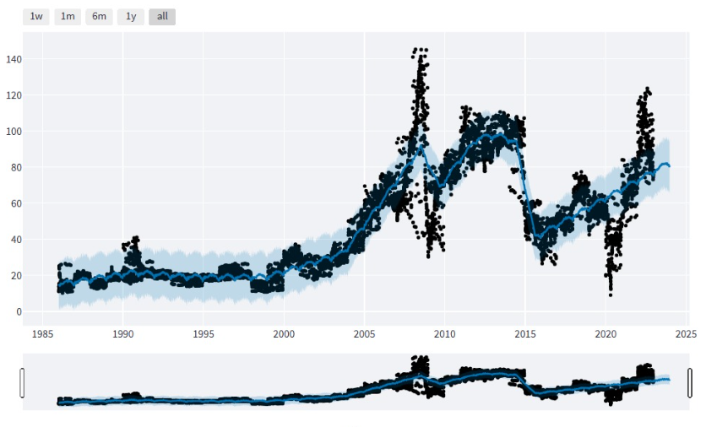
Line Chat
This visualization shows the actual values (“BlackDots”) and predicted values (“Blue line”) over a time.

Slide 40
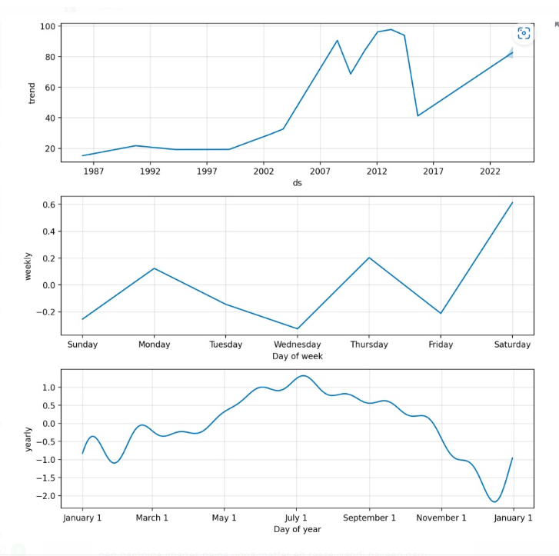
Seasonal components
This visuals shows a high level trend of predicted values, days of week trends, and yearly trends (if dataset covers multiple years). The blue shaded area represents upper and lower confidence interval

Slide 41
Thank you

